Slide 1


Pimpri Chinchwad Education Trust’s Pimpri Chinchwad College of Engineering and Research, Ravet, Pune Department of Computer Engineering
Data Structures
Dr. Govind R. Suryawanshi

Slide 2
Case Study
Garbage Collection

Slide 3
UNIT- III
Stack
Basic concept, stack Abstract Data Type, Representation of Stacks Using Sequential Organization, stack operations, Multiple Stacks, Applications of Stack- Expression Evaluation and Conversion, Polish notation and expression conversion, Need for prefix and postfix expressions, Postfix expression evaluation, Linked Stack and Operations. Recursion- concept, variants of recursion- direct, indirect, tail and tree, backtracking algorithmic strategy, use of stack in backtracking.

Slide 4
Introduction Of Stack

Slide 5
Introduction
A stack is a non-primitive linear data structure.
It is an ordered list in which addition of new data item and deletion of already existing data items done from only one end, known as top tacks (TOP).
As all the deletion and insertion in a stack is done from top of the stack, the last added element will be the first to be removed from the stack.
That is the reason why stack is also called LAST-IN-FIRST-OUT (LIFO) type of list.

Slide 6
Introduction
Example 1: A common model of a stack is plates in a marriage party. Fresh plates are “pushed” onto to the top and “popped” off the top.
Example 2: Some of you may eat biscuits. If you assume only one side of the cover is open and biscuits are taken off one by one from one side.

Slide 7
Introduction
Whenever a stack is created the stack base remains fixed, as a new element is added to the stack from the top, the top goes on increasing.
Conversely as the top most elements of the stack is removed the stack top is decrementing.
Show the next slide figure to various stages of stack top during insertion and during deletion.

Slide 8
Introduction
Stack top increases during insertion
4
4
10
4
20
10
3
3
3
2
2
2
1
1
1
Top=1
0
0
0
Top=0
Stack empty
top=-1
Insert first element
Insert second element

Slide 9
Introduction
Stack top decreases during deletion
4
20
10
4
10
4
3
3
3
2
2
2
1
1
1
Top=1
0
0
0
Top=0
Stack Initially
Element 20 deleted
Element 10 deleted
Top=-1

Slide 10
Stack Implementation
Stack can be implemented in two ways:
Static implementation
Dynamic implementation
Static implementation uses arrays to create stack.
Static implementation though a very simple technique but is not a flexible way of creation, as the size of stack has to be declared during program design, after that the size cannot be varied.
Moreover static implementation is not too efficient with respect to memory utilization.

Slide 11
Stack Implementation
As the declaration of array is done before the start of the operation, now if there are too few elements to be stored in the stack the statically allocated memory will be wasted.
On the other hand if there are more number of elements to be stored in the stack then we can’t be able to change the size of array to increase its capacity.

Slide 12
Stack Implementation
Dynamic implementation is also called linked list representation and uses pointers to implement the stack type of data structure.

Slide 13
Operations on Stack
The basic operation that can be performed on stack are as follows:
PUSH :The process of adding a new element to the top of stack is called PUSH operation. when new element will be inserted at the top after every push operation that top is incremented by one. In case the array is full and no new element can be accommodated, it is called STACK-FULL condition. This condition is called STACK OVERFLOW.

Slide 14
Operations on Stack
POP: The process of deleting an element from the top of stack is called POP operation. After every pop operation the stack is decremented by one. If there is no element on the stack and the pop is performed then this will result into STACK UNDERFLOW condition.
PEEP: If one is interested only about an information stored at some location in a stack then peep operation is required. In short we can say extract any position information from the stack.
UPDATE: Update operation is required when the content of some location in a stack is to be changed.

Slide 15
Stack Terminology
MAXSIZE: This term is not standard one, we use this term to refer the maximum size of stack.
TOP: This term refers to the top stack (TOS). The stack top is used to check stack overflow or underflow conditions. Initially TOP stores -1. this assumption is taken so that whenever an element is added to the stack the TOP is first incremented and then the item is inserted into the location currently indicated by the TOP.

Slide 16
Stack Terminology
STACK UNDERFLOW: This is the situation when the stack contains no element. At this point the top of stack is present at the bottom of the stack.
STACK OVERFLOW: This is the situation when the stack becomes full, and no more elements can be pushed onto the stack. At this point the stack top is present at the highest location of the stack.

Slide 17
Application of Stacks
There are various application of Stack:
Recursion: Recursion is an important facility in many programming language, such as PASCAL and C ect.
Some machine are also known which use built-in stack hardware called ‘stack machine’.
Representation of Polish Notation

Slide 18
Recursion:
Recursion is the name gives to a technique for defining a function in terms of itself.
If is define as “a function call itself, thus chain of process occurs.”
There are two important conditions that must be satisfied by any recursive procedure:
Each time a procedure calls itself, it must be “nearer” in some sense solution.
There must be a decision criterion for stopping the process or computation.

Slide 19
Recursion:
There are three popular implementation of recursive computations:
Calculation of factorial value
Quick sort
Tower of Hanoi problem
Very simple example is to find Factorial value for an integer n:
n!=n*(n-1)*(n-2)*……..*3*2*1
n!=n*(n-1)!

Slide 20
Recursion:
What is the simple implementation of factorial calculation:
fact=1
For(i=1 to N) do
Fact=i*fact
End for
Return(fact)
Stop

Slide 21
Recursion:
Now let us see the recursive definition of the same.
1. if (N==0)
2. fact=1
3. else
4. fact=N*FACTORIAL(N-1)
5. end if
6. return (fact)
7. Stop
This recursive definition to implementation using stack show in word file.

Slide 22
Tower of Hanoi Problem
Another complex recursive problem is the tower of Hanoi problem.
This problem has a historical basis in the ritual of ancient Vietnam.
The problem can be described as below:
Suppose, there are three pillars A,B,C. there are N discs of decreasing size so that no two discs are of the same size.
Initially all the discs are stacked on one pillar in their decreasing order of size.

Slide 23
Tower of Hanoi Problem
Let this pillar be A. other two pillars are empty.
The problem is to move all the discs from one pillar to other using as auxiliary so that
Only one disc may be moved at a time.
A disc may be moved from any pillar to another.
At no time can a larger disc be placed on a smaller disc.

Slide 24
Tower of Hanoi Problem
The solution of this problem is: Move N discs from Pillar A to C via the pillar B means:
Move first (n-1) discs from pillar A to B
Move the disc from pillar A to C
Move all (n-1) discs from pillar B to C
This problem implementation to show in word file.

Slide 25
Polish Notation
The process of writing the operators of an expression either before their operands or after them is called the polish notation.
The fundamental property of polish notation is that the order in which the operations are to be performed is completely determined by the positions of the operators and operands in the expression.

Slide 26
Polish Notation
The polish notation are classified into three categories.
These are:
Infix notation
Prefix notation
Postfix notation

Slide 27
Introduction
Operator Precedence Table:
Operator Name | Operator | Highest Precedence | Association
All types of Brackets | (),[],{} | 1 | Left-Right
Exponential | ^ or $ or ↑ | 2 | Right-Left
Mulitplication/ Devision | *,/ | 3 | Left-Right
Addition/ Subtraction | +,- | 4 | Left-Right

Slide 28
Algorithm for Infix to Post Fix
Step 1 : Scan the Infix Expression from left to right.
Step 2 : If the scanned character is an operand, append it with final Infix to Postfix string.
Step 3 : Else,
Step 3.1 : If the precedence order of the scanned(incoming) operator is greater than the precedence order of the operator in the stack (or the stack is empty or the stack contains a ‘(‘ or ‘[‘ or ‘{‘), push it on stack.
Step 3.2 : Else, Pop all the operators from the stack which are greater than or equal to in precedence than that of the scanned operator. After doing that Push the scanned operator to the stack. (If you encounter parenthesis while popping then stop there and push the scanned operator in the stack.)
Step 4 : If the scanned character is an ‘(‘ or ‘[‘ or ‘{‘, push it to the stack.
Step 5 : If the scanned character is an ‘)’or ‘]’ or ‘}’, pop the stack and and output it until a ‘(‘ or ‘[‘ or ‘{‘ respectively is encountered, and discard both the parenthesis.
Step 6 : Repeat steps 2-6 until infix expression is scanned.
Step 7 : Print the output
Step 8 : Pop and output from the stack until it is not empty.

Slide 29
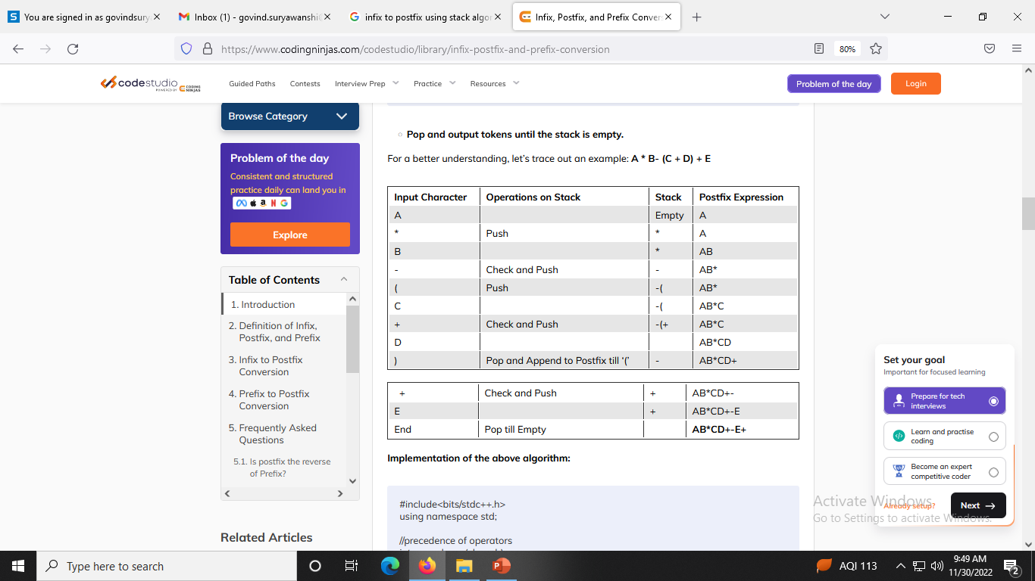

Slide 30
Examples
Infix expression to postfix form:
A*B+C
=(AB*)+C
=T+C :AB*=T
=TC+
=AB*C+ :puts the value of T

Slide 31
Examples
A*B+C/D
=(AB*)+C/D
=T+C/D :AB*=T
=T+(CD/) :CD/=S
=T+S
=TS+
=AB*CD/+ :put the value of T & S

Slide 32
Examples
(A+B)/(C-D)
=(AB+)/(C-D)
=(AB+)/(CD-)
=T/S :T=AB+ & S=CD-
=TS/
=AB+CD-/ :put the value of T & S

Slide 33
Examples
(A+B)*C/D
=(AB+)*C/D
=T*C/D :T=AB+
=(TC*)/D :S=TC*
=S/D
=SD/
=TC*D/ :put the value of S
=AB+C*D/ :put the value of T

Slide 34
Examples
To solves these examples:
(A+B)*C/D+E^F/G
Ans: AB+C*D/EF^G/+
A-B/(C*D^E)
Ans: ABCDE^*/-
(a + b↑ c↑ d) * (e + f / d)
Ans:abcd ↑↑+efd/+*

Slide 35
Examples
Infix expression to prefix form:
A*B+C
=(*AB)+C
=T+C :T=*AB
=+TC
=+*ABC :put the value of T

Slide 36
Algorithm for Infix to Prefix
First, reverse the infix expression given in the problem.
Scan the expression from left to right.
Whenever the operands arrive, print them.
If the operator arrives and the stack is found to be empty, then simply push the operator into the stack.
If the incoming operator has higher precedence than the TOP of the stack, push the incoming operator into the stack.
If the incoming operator has the same precedence with a TOP of the stack, push the incoming operator into the stack.
If the incoming operator has lower precedence than the TOP of the stack, pop, and print the top of the stack. Test the incoming operator against the top of the stack again and pop the operator from the stack till it finds the operator of a lower precedence or same precedence.
If the incoming operator has the same precedence with the top of the stack and the incoming operator is ^, then pop the top of the stack till the condition is true. If the condition is not true, push the ^ operator.
When we reach the end of the expression, pop, and print all the operators from the top of the stack.
If the operator is ')', then push it into the stack.
If the operator is '(', then pop all the operators from the stack till it finds ) opening bracket in the stack.
If the top of the stack is ')', push the operator on the stack.
At the end, reverse the output.

Slide 37
Examples
A/B^C+D
=A/(^BC)+D
=A/T+D :T=^BC
=(/AT)+D
=S+D :S=/AT
=+SD :put the value of S
=+/ATD :put the value of T
=+/A^BCD

Slide 38
Examples
(A*B+(C/D))-F
=(A*B+(/CD))-F
=(A*B+T)-F :T=/CD
=((*AB)+T)-F
=(S+T)-F :S=*AB
=(+ST)-F :R=+ST
=R-F
=-RF
=-+STF :put the value of R
=-+*ABTF :put the value of S
=-+*AB/CDF :put the value of T

Slide 39
Examples
Postfix expression to Infix form: to evaluate expression from left to right
AB*C+
=(A*B)C+
=TC+ :A*B=T
=T+C
=A*B+C :put the value of T

Slide 40
Examples
ABC/+D-
=A(B/C)+D-
=AT+D- :T=B/C
=(A+T)D-
=SD- :S=A+T
=S-D
=A+T-D :put the value of S
=A+B/C-D :put the value of T

Slide 41
Examples
AB+C*D/
=(A+B)C*D/
=TC*D/ :T=A+B
=(T*C)D/
=SD/ :S=T*C
=S/D
=T*C/D :put the value of S
=(A+B)*C/D :put the value of T

Slide 42
Examples
Prefix expression to Infix form: to evaluate expression from right to left
+*ABC
=+(A*B)C
=+TC :T=A*B
=T+C
=A*B+C :put the value of T

Slide 43
Examples
-/A^BCD
=-/A(B^C)D
=-/ATD :T=B^C
=-(A/T)D
=-SD :S=A/T
=S-D
=A/T-D :put the value of S
=A/B^C-D :put the value of T

Slide 44
Examples
Postfix Expression Evaluation: to evaluate expression from left to right
345*+
=3(4*5)+
=3 20 +
=3+20
=23

Slide 45
Examples
Prefix Expression Evaluation: to evaluate expression from right to left
+*213
=+(2*1)3
=+ 2 3
=2+3
=5

